Slide 1
SIGNET JEWELERS Inventory Management System (IMS) Orals
28th March 2018

Slide 2


Agenda
Executive Summary & Solution Overview
IMS Modernization Approach
Testing Approach
Project Organization & Governance
Application Maintenance & Support

Slide 3
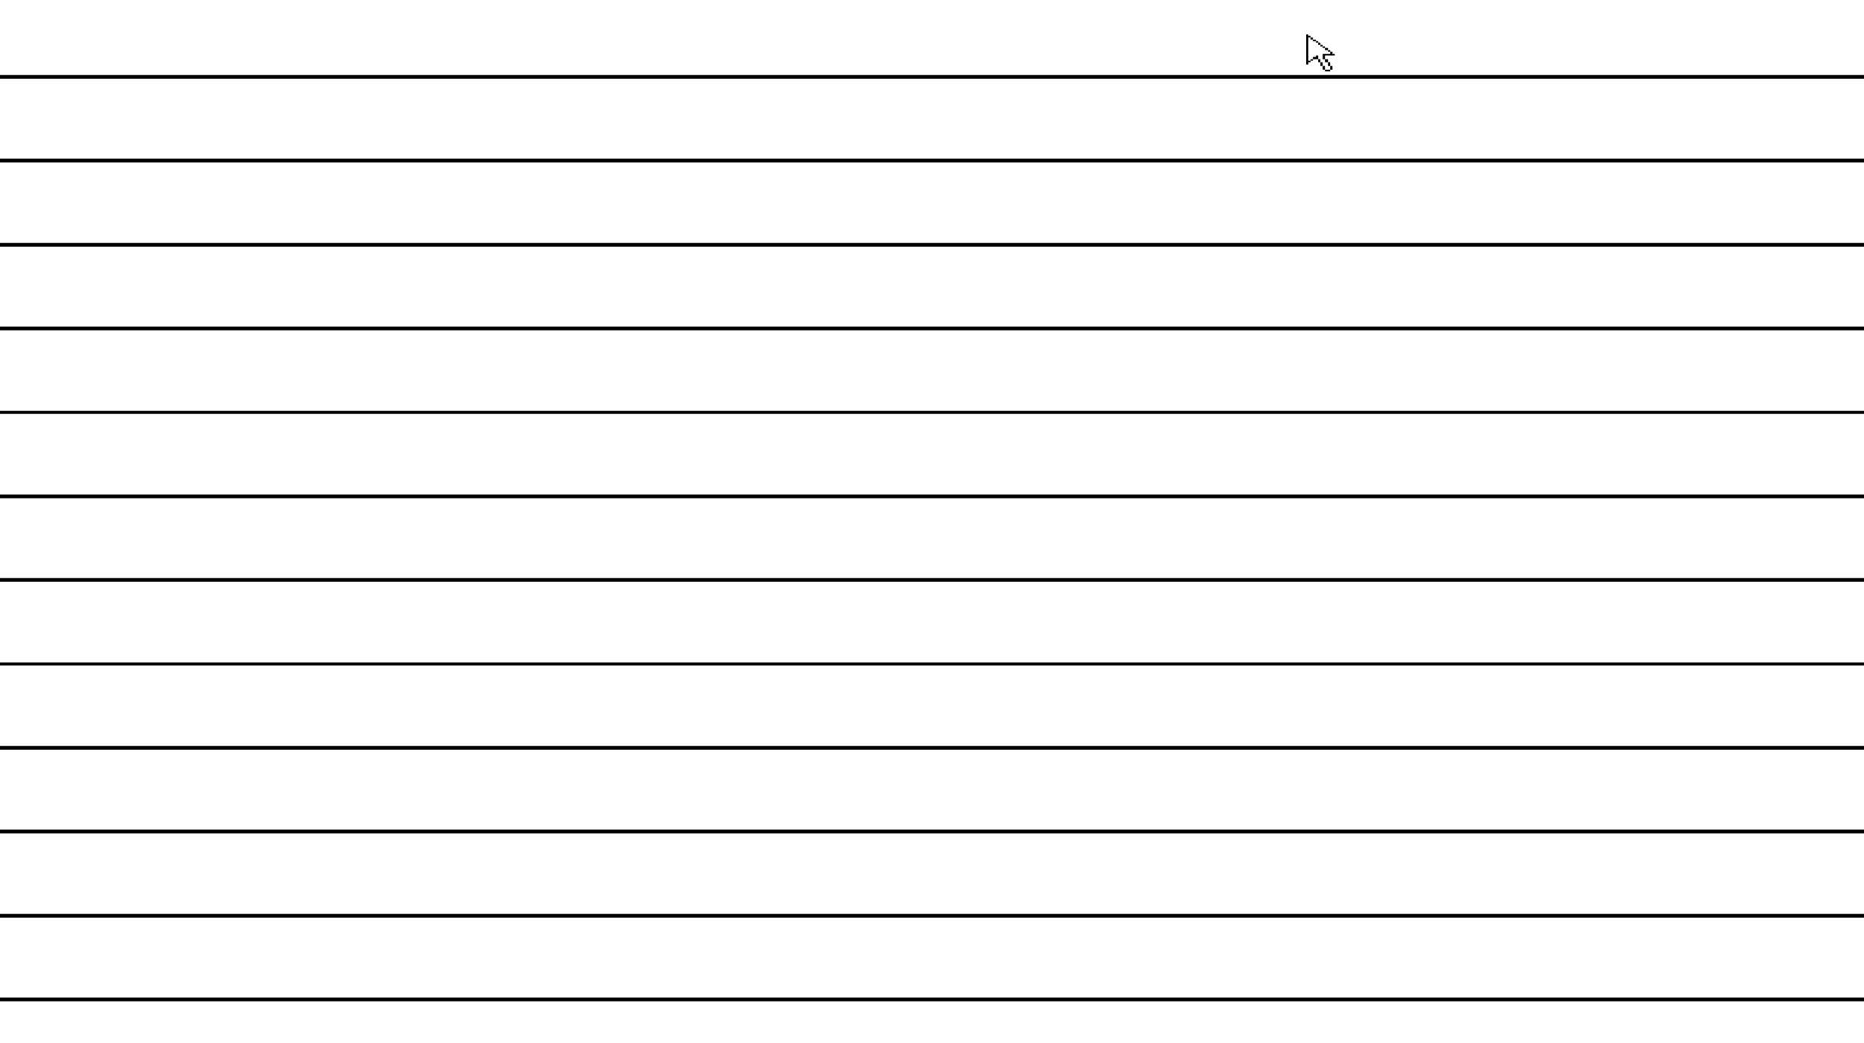

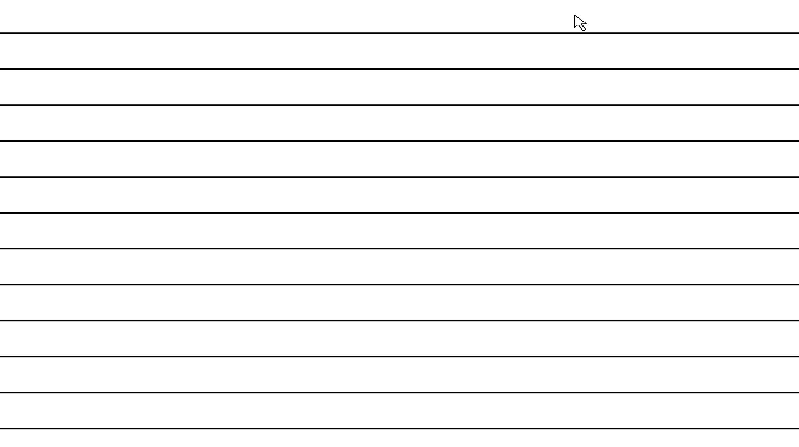


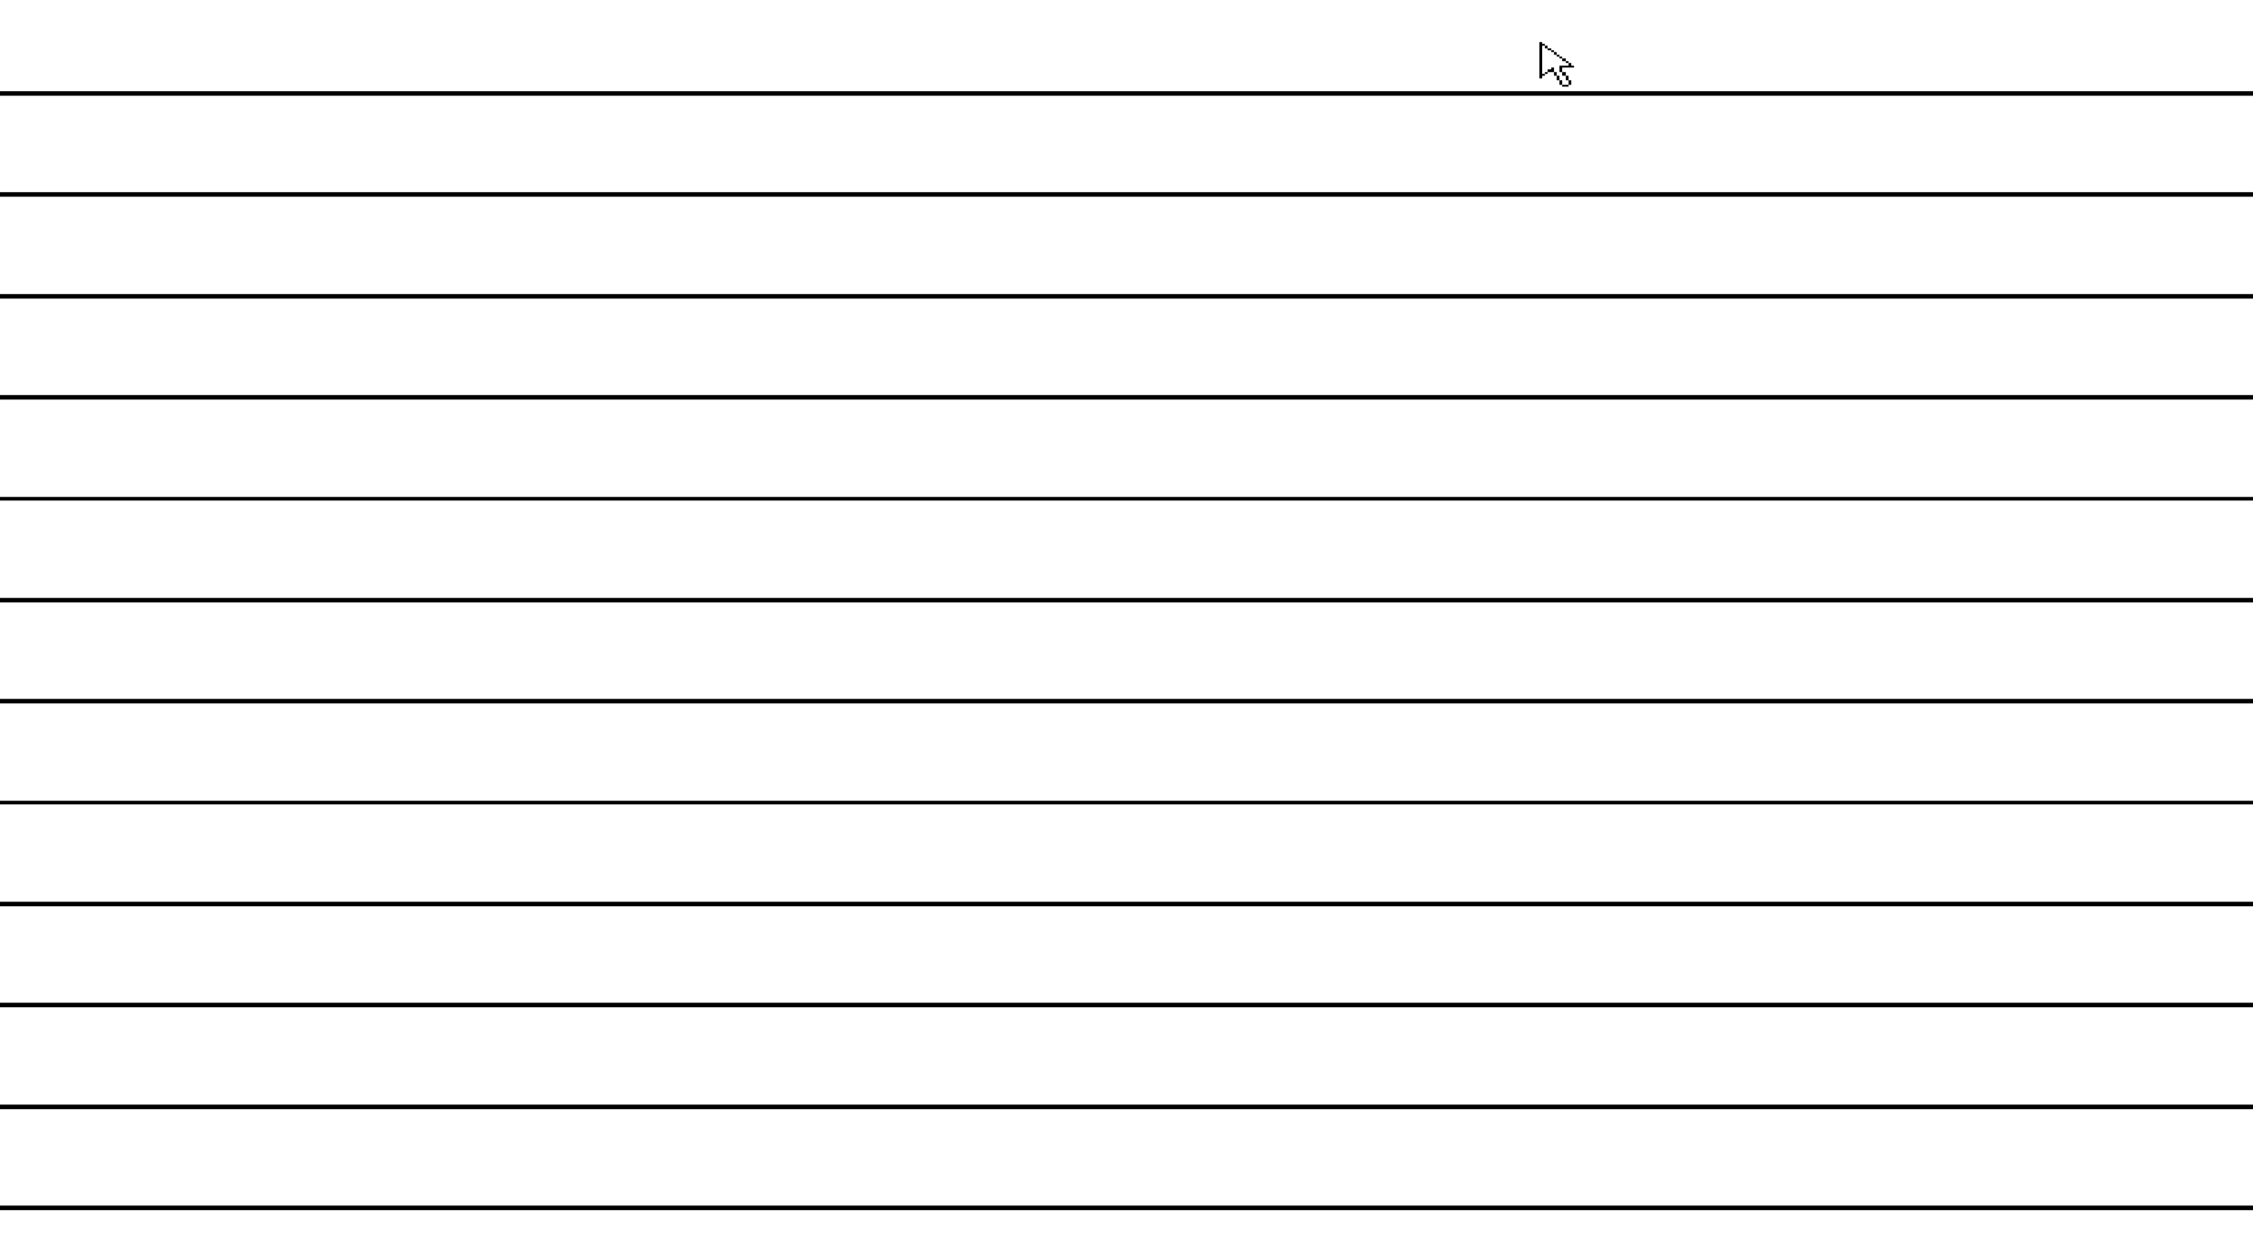

What we want to accomplish by partnering with you
Change Management
Signet
Signet
People
Current state
Risks
Future State
Current Environment
Celebrate life, express love
Celebrate life, express love
Journey With A Trusted Partner

Slide 4

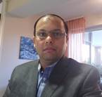
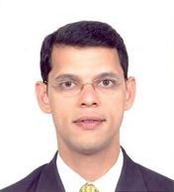
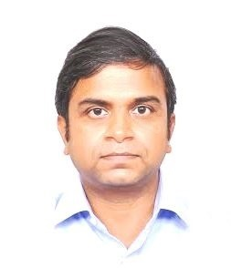

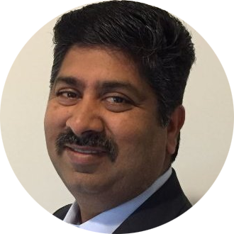
Our Team Today….
Michael Jafari
Sales Director
Parth Patel
Solution Architect
Rahul Deshpande
Testing Lead
Vinod Kumar
Umar Farook
Delphi SME
Kumar Thirumalai
Chief Architect
Sr. Solution Architect

Slide 5
Executive Summary & Solution Overview

Slide 6






Key Objectives of IMS Modernization Program
Modernize the IMS application using newer Technologies
ASIS Business transformation
Retain current functionality
Address Risk
No disruption to Business
New modernized IMS platform
Objectives
Outcomes
Minimize end user impact
Improve Efficiency
Improve scalability
Complete Modernization in 18 months
Improve Performance
Retain/Improve the performance of the existing application
Improve Reliability

Slide 7
Additional Take away from the Interim Presentation
Solution with Optimal Pricing
Gradual Transition of Applications
Application Release Methodology to Minimize Business Impact
Support KPI, SLAs and Metrics to showcase Improved Efficiency Over Time
Specific Technical Solutions to address
1) Printing at desktops without printer prompts
2) Large data set retrieval for product searches
3)Desktop sharing allowing simple login

Slide 8
Delphi Code – Inventory Collection & Observations
Source code size
394 Projects
1887 Class
16 Custom packages
1542 Forms
3rd Party Libraries
JEDI Visual Component Library
kbmMemTable Designtime
Rave Reports
Sell Pricing (Phase 1)
11 Projects
27 Forms
26 Class
2 Custom packages
IMS Components
Database login and error dialog components
SPS Components
Database validation control to validate user entries against sell price master database
Sterling Components
Data entry controls - DB entry, SKU entry, Vendor entry
Database grid
Control that writes list view data to CSV
Database connection component that uses login controls from IMS_ORA package
Multi column sorting control, number edit control, customized list view
Database list view, Location entry, Template Tree view
Database validation control to validate user entries against SKU_MASTER, location, division, VENDOR_MASTER db
Label edit alignment controls
Customized Rave report project component
IMS Common Files
Frames – Store selection, Location attributes, Location Division frame controls
Dialogs – Calendar, Vendor select, Sort control, Select printer, IMS Comment Dialog
Libraries – Data tier components
Graphics – Icons
Forms – Reusable forms
SPS Common Files – Comment dialog control
Custom Packages

Slide 9
Our Solution Guiding Principles
Start Small
Transform
Run Better
Build the Foundation for Modernization
Transform to “Best in Class” Technology
Next Gen IT Managed Services through Innovation
Perform Proof Of Concept
Iterative “WAVE” implementation
Business-aligned SLA’s & KPI
Identify Risks
Reduce Business Risks
Productivity Improvement
Leverage Our Experience
Utilizing Tools & Accelerators
Low Cost & Efficient Operating Model
Modernization Strategy
Testing Center of Excellence
Create Support SMEs

Slide 10
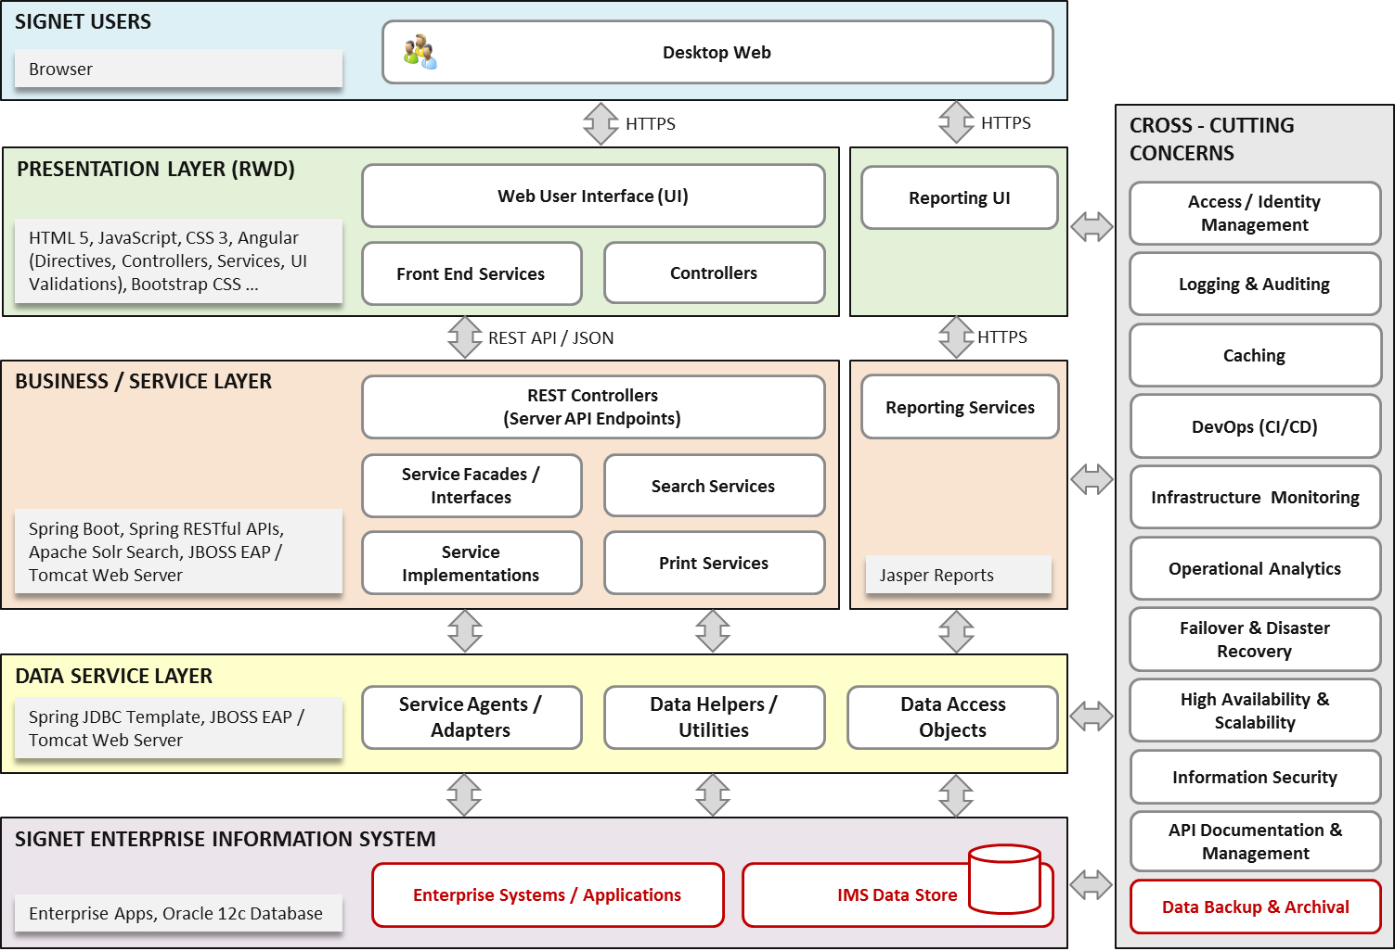
Proposed IMS High Level Architecture
Layered architecture with clear separation of concerns with cohesive and loosely coupled components

Slide 11
We have delivered Modernization
Large US Based Insurance Company
US Grocery Supermarket Chain
US Largest Car Retailer
Brazil
Legacy Modernization of LIFTS application from Delphi to Java
Key application modernization to Java Platform
Enable calculation accuracy of Business rules, TAX & FEE by maintaining single source of truth Rewritten in .NET technologies
37,100 Lines of Code developed in 9 Sprints
Integration through TIBCO & Micro Strategy Reporting
Agile Methodology project Delivery
28 Screens & 17 Worksheets developed across 2 Lines of Business
Mainframe Revitalization to reduce TCO
Onshore / Offshore model using 50/50 ratio with required skillset for SDLC

Slide 12

Key capabilities required from Partner of choice
Market Competitive Costs
Zero Impact Execution and Transition
People and Cultural Fit
Best in Class solution
Proven credentials and demonstrated delivery record

Slide 13
IMS Modernization

Slide 14
Delivery methodology for each application
Plan/Analyze
Reverse Engineering
Forward Engineering
Test
Implement/Go-Live/Support
Definition
Business
Rules
Extraction
Finalize Functional Specifications and Configuration
Design
System
Testing
Rollout/
Implement
Hyper care/
Warranty
Support
after each Go-Live
Initiation
Due-Diligence & Planning
Non-
Functional
Requirements
Build and Unit
Testing
User
Acceptance
Testing
Program Management – Onsite and Offshore
Governance – Onsite and Offshore

Slide 15
How did we arrive at Effort?
Estimation engine
15%-25%-35%-25% (Very high, high, low, very low complexity)
20% reusable code, Testing automation
Productivity Factor
Delphi apps - 425
Line of code – 1.3 Million
Timeline – 18 Months
Overall program effort of 23,733 PD
Implementation timeline of 24 months

Slide 16
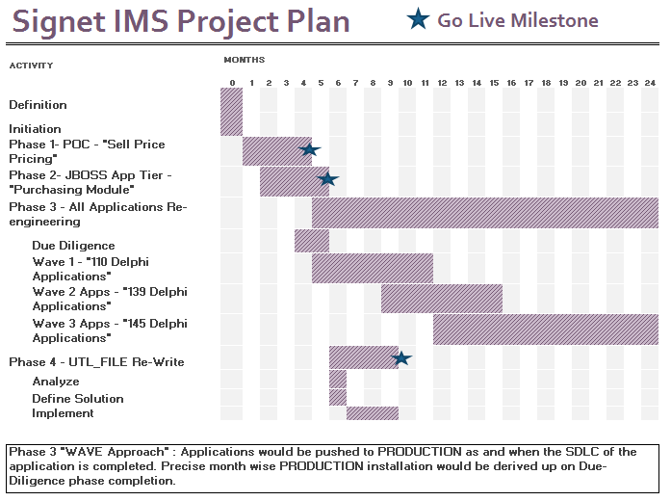
Execution Plan

Slide 17
Phase 1 – Proof Of Concept
Objective:
“Proof of Concept” (POC) Phase – Modernize the “Sell Pricing” application to Java utilizing existing Signet WebSphere environments
High Level Project Plan:
ACTIVITY |  | MONTHS
 |  | 0 | 1 | 2 | 3 | 4
Phase 1- POC - "Sell Pricing"
Due Diligence
Reverse Engineering
Requirement Analysis
Design
Construction & Unit Testing
System Integration Testing
User Acceptance Testing
Rollout/Implementation
Scope:
Cognizant identified 9 Delphi Apps as part of “Sell Pricing” module.
Using Functional Point Estimation Model, the total effort is 52.75 PM
Outcome:
Modernized “Sell Pricing” module installed in JAVA WebSphere environment

Slide 18
Phase 2 – JBOSS App Tier
Objective:
JBOSS App Tier Phase – Modernize the “Purchasing” application to Java utilizing existing Signet JBOSS environments
High Level Project Plan:
ACTIVITY |  | MONTHS
 |  | 0 | 1 | 2 | 3 | 4 | 5
Phase 2- JBOSS App Tier - "Purchasing Module"
Due Diligence
Reverse Engineering
Requirement Analysis
Design
Construction & Unit Testing
System Integration Testing
User Acceptance Testing
Rollout/Implementation
Scope:
Cognizant identified 22 Delphi Apps as part of “Purchasing” module.
Using Functional Point Estimation Model, the total effort is 49.25 PM
Outcome:
Modernized “Purchasing” module installed in JAVA JBOSS environment

Slide 19
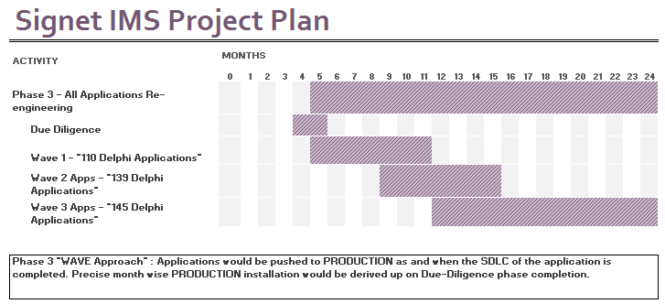
Phase 3 – All Remaining Applications – Phased Implementation “Not a big bang”
Objective:
Modernize the applications to Java utilizing existing Signet JBOSS environments in phased approach
Notes:
Approach:
Cognizant proposes “WAVE” based approach to modernize all the remaining applications.
Each “WAVE” will not be “Big Bang”. Applications will be installed to PROD in a staggered way within a WAVE.
Benefits:
Mitigating the risk of “Big Bang” application release
Minimal disruption to Business
Optimal usage of Change Management
Effective co-ordination between focused team
Reduced peak team size, there by optimal resource utilization
Scope
Cognizant identified remaining applications to have 394 Delphi Apps
WAVE 1 – 110 Delphi Applications
WAVE 2 – 139 Delphi Applications
WAVE 3 – 145 Delphi Applications
Using Functional Point Estimation Model, the total effort is 1074 PM

Slide 20
Phase 4 – UTL_FILE Rewrite
Objective:
Re-Write of Oracle UTL_FILE so that the database is secured, scalable and zero downtime to make directory/file changes
High Level Project Plan:
ACTIVITY |  | MONTHS
 |  | 0 | 1 | 2 | 3 | 4 | 5 | 6 | 7 | 8 | 9 | 10 | 11 | 12 | 13 | 14 | 15 | 16 | 17 | 18 | 19 | 20 | 21 | 22 | 23 | 24
Phase 4 - UTL_FILE Re-Write
Scope:
Outcome:
MIGRATING FROM UTL_FILE_DIR
Identify where UTIL_FILE is used
Create Directories
Change FOPEN calls to use Directories
Edit UTL_FILE_DIR to remove physical Directories
System Testing
Secure & Scalable database
Notes:
Approach:
Cognizant proposes “WAVE” based approach to modernize all the remaining applications.
Each “WAVE” will not be “Big Bang”. Applications will be installed to PROD in a staggered way within a WAVE.
Benefits:
Mitigating the risk of “Big Bang” application release
Minimal disruption to Business
Optimal usage of Change Management
Effective co-ordination between focused team
Reduced peak team size, there by optimal resource utilization
Scope
Cognizant identified remaining applications to have 394 Delphi Apps
WAVE 1 – 110 Delphi Applications
WAVE 2 – 139 Delphi Applications
WAVE 3 – 145 Delphi Applications
Using Functional Point Estimation Model, the total effort is 1074 PM

Slide 21







Program Critical Success Factors
Availability of Delphi Specialists
Signet’s IT Business analyst & IT SME Involvement
Well defined, functional & non-functional requirements
Timely access provisioning for Cognizant team members as and when on-boarded
Dev & QA Test data mirroring PROD
Defined Governance structure and escalation pathway
Committed, active and aligned executive leadership and stakeholders
Measuring effectiveness through Metrics
Strong communication plans/process to facilitate smooth delivery process

Slide 22
Phase wise Activities
PROJECT INITIATION PHASE
PHASE
PHASE
PHASE
PHASE
PHASE
PHASE
PHASE
Project goals
Project Roadmap and Key Milestones
Approved Project Charter
Prepare Rollout Strategy
Prepare Re-engineering Strategy
Risk and Mitigation Plan
System tested code
Setup and configure the software in acceptance environment
Readiness check of Production environment
Approved Inventory Blueprint
Architecture Definition
Environment Definition
Coding and Design Standards
Approved Design Document
Support offshore team in development activities
Profile and Refactor Code
Onsite
Approved BRE Specs
Design system capabilities
Setup Development Environment
Unit tested source code
Support offshore team during integration/system test
GO LIVE Ready
Perform Production Rollout
Hyper care Support
DUE DILIGENCE
Perform AS-IS Code base and Inventory Analysis
REVERSE ENGINEERING
Business Rules Extraction
Elicit AS-IS Non-Functional Requirements
Establish Traceability Matrix
DESIGN
Prepare integration test plan/cases
HLD/LLD Design document
Refine Traceability
CODING & UNIT TESTING
Code the system as per design
Perform unit tests and fix defects identified
Source control of developed code
Unit tested code
INTEGRATION & SYSTEM TESTING
Perform integration/System tests
Perform Performance and Security Tests
System tested code
USER ACCEPTANCE TESTING
Perform User Acceptance testing
Perform Performance and Security Tests
Implementation Plan and Rollback plan
IMPLEMENTATION
Fix Post-Production Defects
Handover document to Managed Services Team
Hyper care support
Offshore

Slide 23
Risk Insights – What can go wrong?
Risk | Mitigation Plan
Infrastructure, Data and Access: Delay in application access and infrastructure setup for Cognizant for onsite and offshore Non-availability of infrastructure for development, Test & Go-Live Unavailability of connectivity and licenses for the tools/software/Licenses Data quality in Dev, QA should mirror PROD for effective testing | Cognizant to share all the necessary access & Infrastructure details required during the project initiation phase Signet Infrastructure team to provide the required infrastructure before the start of the Development, Test & Go-Live Phases Infrastructure team to ensure Cognizant team gets the necessary connectivity and access to tools/software required for the execution of the project on time Signet to provide high quality data in Dev, QA that mirrors PROD data
Resource Availability and Gate Reviews Non-Availability of Signet Application and IT SME in the right time Delay in sign-off for each deliverable Inability to start the project on time due to lack of resources | The project schedule and calendar will be communicated on a weekly basis to the relevant participants Ensuring availability of Signet SMEs for the required review and sign-off Cognizant will identify Day-1 profiles and commit to Signet on their availability
Change Management Changes to the existing UI layout and additional development process can extend the timeline Technical incompatibilities uncovered during implementation that are not considered during Design Not factoring the environment responsiveness during the solution design will impact process execution | Any changes to the existing UI should be taken as “Change Request” Cognizant to proactively identify technical incompatibilities and involve CoE (Center of Excellence) if need arises Detailed Non-functional requirements to be captured and signed-off

Slide 24










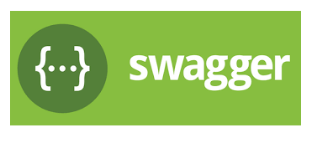














Recommended tools
PLAN
CODE
BUILD
DEPLOY
TEST EXECUTION
Release and Monitor
Support
Plan/ Track / Code
Build / Deploy / Measure Code Quality
Test / Release/ Monitor / Support
SmartStub
AppInsights
KTNavigator
Open Source Tools
Cognizant Accelerators
Licensed Version/Cost Associated

Slide 25
Testing Approach

Slide 26













Our Holistic Testing Approach
COGNIZANT MIGRATION TESTING APPROACH
QA OBJECTIVES
Application Readiness Prep
QA OUTCOMES
Assured Quality for IMS Code Modernization
Batch Jobs Testing
Sanity Testing
Defect Free IMS Code Modernization
End Point URLs Verification
Automation Focus
Functional Testing
Cross Browser Testing
Faster Testing Cycles thru Structured Automation
Test Case Baselining
MIGRATION
Performance Testing
Structured Documentation
PRE-MIGRATION
POST-MIGRATION
Centralized Knowledge Repository
Integration Testing (Legacy & Downstream Systems)
Security Testing
Measure QA Performance
Automation Feasibility Analysis
MIGRATION PREP
Integrated QA Metrics Dashboard
Structured Defect Management Process
Sanity Testing & NFT Benchmarking
QA Tools Identification
Automated Regression Execution
Business Process Validation (E2E)
Centralized Test Process Repository
IMS Performance
Modernized apps performance >= benchmark
Migration Test Strategy
START
UAT Support
QA INITIATIVES
OUR EXPERTISE
Knowledge Management
Test Process Repository
Defect Management Process
Intelligent Quality Dashboard
Automated Design & Regression Analysis
Automation First Approach
Service Virtualization
20+ Retail Clientele with IMS Testing
100+ SCM & Stores QA Professionals with IMS Expertise
1,500+ Reusable IMS Test Scenarios
25+ IMS E2E Business Process Flows

Slide 27








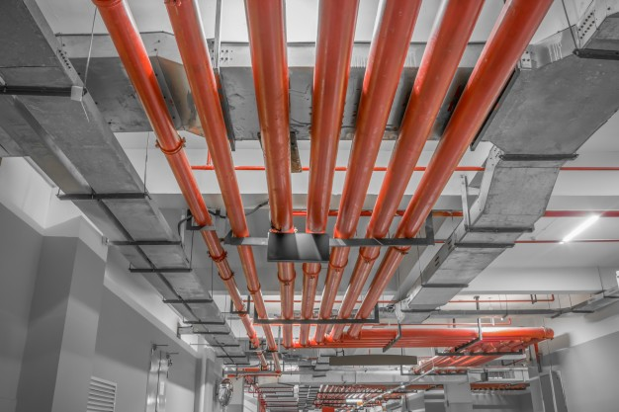





QA Solution Summary
KNOWLEDGE MANAGEMENT
CARTS Powered Reusable IMS Scenario Repository
TEST DESIGN & AUTOMATED REGRESSION ANALYSIS
Faster Test Design, Regression Analysis using ADPART
TEST PROCESS REPOSITORY
Centralized QA Repository of standard process & deliverables
PROCESS TRANSFORMATION
AUTOMATION FIRST APPROACH
Scriptless automation for Regression & Cross-Browser Testing using CITS
TECHNOLOGY TRANSFORMATION
DEFECT MANAGEMENT PROCESS
Structured process to manage defect lifecycle across SDLC
SERVICE VIRTUALIZATION
Improve Service Availability and Reduce Downtime powered by SmartStub
INTELLIGENT QUALITY DASHBOARD
Single View of Quality for entire IMS Program
Phase 1
Phase 2
Phase 3

Slide 28

QA Roadmap
Phase-1
Phase-2
10%
Test Design Effort Reduction
E2E Model Flow for Business Validation
POC for
Sell Price
Purchasing
Single View of
Application Quality
Phase-3
M1 – M4
M2 – M5
SmartStub
M5 – M10
M9 – M15
M14 – M23
Receiving New Merch
Merchandise Evaluation
Merchandising
Inventory Control
PI (Physical Inventory)
Distribution (DC)
Recalls STS
Store & Vendor Returns
Special Orders & Inquiry
Diamond Room
Manufacturing & Transfers
Acctg.Finance
AP (Account Payable)
System Maint and Misc
Wave 1
Wave 2
Wave 3
SV Platform Enables early testing for interfaces
CITS | JMeter | IBM App Scan

Slide 29
Project Organization & Governance

Slide 30




Project Organization
Signet Team
Cognizant Team
Onsite
Offshore
STEERING COMMITTEE
Business Sponsor(s)
Engagement Partner
Delivery Manager
PROGRAM
MANAGEMENT
OFFICE
Engagement Lead
Program Manager
Project Manager
PROJECT DELIVERY
TEAM
Business SMEs
Business Analyst
Delphi
Specialists
JAVA Developers
SIT & UAT Testers
Architect
DevOps Specialist
IT SMEs
Project Manager
Test Lead
JAVA Lead
Signet Team
Cognizant Onsite
Cognizant Offshore
Cognizant – Client Communication
Cognizant Internal Communication

Slide 31



Program Governance Structure
Engagement Structure: Incorporating strong envisioning, planning and execution capabilities
Joint
Governance
Client Partner, Engagement Partner & Delivery Partner
Signet Business Leadership
Strategic (Quarterly)
1
1
Client Partner, Delivery Partner, Engagement Partner Engagement Lead, Delivery Lead
Executive Steering Committee
Project Sponsor, Project Manager
Tactical
(Monthly)
2
Reporting and Escalations
2
Delivery Lead, Project Manager and Team leads
Engagement Management
Committee
3
Operational
(Daily)
Delivery Managers, Application Owners, BU Leads & PMO
3
Program Management
Objectives: Alignment, Communication, Risk Management, Ownership, Conflict resolution, Compliance

Slide 32
Signet Involvement
Particular's | Project Phases | SME with Business Knowledge | SME with Application Knowledge | Enterprise Architect | SME with IT/Infra Knowledge | Project Manager
IMS Modernization Program | Due Diligence |  | 50% |  | 50% | 50%
 | Reverse Engineering | 50% | 50% |  |  | 25%
 | Requirement Analysis |  | 50% |  |  | 25%
 | Design & Code Review |  | 25% | 50% |  | 10%
 | Coding & Unit Testing
 | System & Integration Testing |  |  |  | 10% | 25%
 | User Acceptance Testing | 25% | 25% |  |  | 25%
 | Rollout |  |  |  | 50% | 25%

Slide 33
Signet Roles & Responsibilities
Role | Key Responsibilities
Project Manager (PMO Office) | Single point of contact from Signet for key facilitation and escalations Mitigate the project risks on time Review and allocate other Signet technical and business SME time as per the plan requested by Cognizant Coordinate with other internal Signet teams for providing all relevant infrastructure including environments for development of the new application, within the schedule requested by Cognizant
Business & Application SMEs | Provide inputs to wireframe and visual design Provide sign off on requirements, wireframe, visual design and html Review and signoff of reverse engineering document
Architect | Sign off on technology stack and non-functional requirements Review and sign off design document and architecture blueprint
Infrastructure SME | Provide all required access to Cognizant resources to perform reverse engineering and development Assist with relevant information relating to existing integrations for IMS system

Slide 34
Application Maintenance & Support

Slide 35
Application Support Managed Services Scope
The Scope of work includes Level 2 and Level 3 support comprising Incident Management, Problem Management and Change Management of modernized IMS application.
In Scope
Out of Scope
Incident Management- Investigate, diagnose and resolve incidents
Service Request Fulfilment- Focus on non-standard service requests, not documented in knowledge database
Problem Management- Root cause analysis to prevent high priority and recurring incidents
Change Management - including minor enhancements less than 80 hours effort
Level 1 support– Help desk
Batch Support
Database administration, monitoring and management
Infrastructure administration, monitoring and management
Identity and access management of the application.
Application Support for Delphi Application during parallel run and/or till Delphi application is sunset
Support for any application which is not part of modernization/ development project scope
Support Window
Cognizant is proposing service window as mentioned below:
Support during normal hours of operations at onsite (EST) and at offshore (IST)
24X7 Support through On-call for P1 and P2 tickets, post notification about the same from Help Desk/Service Now alerts

Slide 36
Key highlights of Cognizant Support solution
Gradual resource ramp up plan aligned to development timelines and shorter KT durations
Well defined Handover to Support processes for seamless takeover by support
ITIL based support – process standardization across engagement
Metrics driven delivery- focus on SLAs & KPIs , reporting & dash boarding and ITSM tool integration (Service Now)
24x7 Level 2 and Level 3 support leveraging our Onshore-offshore model (combination of in office and on call support)
Continual service improvements to drive productivity improvements

Slide 37
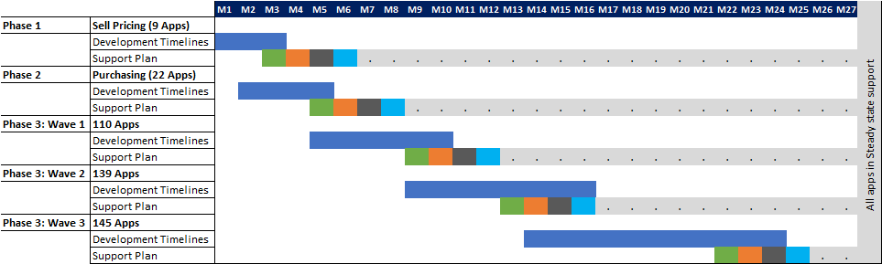
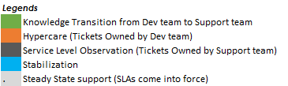
Support team ramp up is aligned to development milestones
Cognizant is proposing a phased approach to on-board applications under its support. This approach is tightly aligned to the modernization project plan

Slide 38
Development to Support Transition
KNOWLEDGE TRANSFER
Critical Success Factors
HoTS process defined to ensure minimal business impact
Early involvement and continuous communication with AMS team.
Go/No Go Decision for production “Go Live” should include Support Readiness
Transition from Hyper-Care to SLO dependent on Checklist completion as part of ‘Acceptance into Service” process.
PLANNING
Abbreviations/Definitions
SLO – Service Level Observation
SLA - Service Level Agreement
AMS – Application Maintenance Services
HoTS- Handover to Support

Slide 39
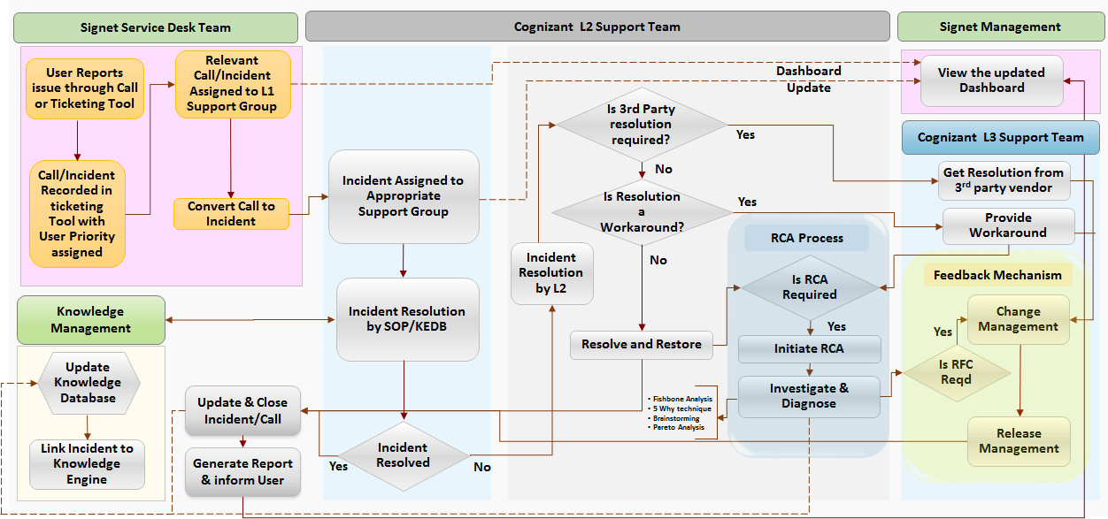
ITIL aligned support processes to bring in standardization across support groups

Slide 40
SLAs and KPIs for application support
Key SLAs
Response Time for Incidents
Resolution Time for Incidents
Problem RCA Submission
RCA Closure
Availability SLA
Service Request SLA
SLA adherence commitments for Incidents and RCAs:
Service Level | Response SLA Duration |  |  |  | Resolution SLA |  |  |  | SLA Commitment (Response & Resolution)
 | P1 | P2 | P3 | P4 | P1 | P2 | P3 | P4 | P1 | P2 | P3 | P4
Incidents | 30 Min | 4 hours | 1 BD | 2 BD | 4 hours | 1 BD | 2 BD | 10 BD | 99% | 97% | 95% | 95%
Service Level | Preliminary RCA |  |  |  | Resolution SLA |  |  |  | SLA Commitment (Response & Resolution)
 | P1 | P2 | P3 | P4 | P1 | P2 | P3 | P4 | P1 | P2 | P3 | P4
Problem tickets (Root cause analysis) | 3 BD | 5 BD | 12 BD | 20 BD | 5 BD | 7 BD | 25 BD | 16 BD | 95% | 95% | 90% | 90%
KPIs/SLA will be applicable only after 3 months in steady state
A mutually agreed Risk / Reward mechanism for SLA performance will be established .

Slide 41
Productivity improvement over the Engagement Period
KEY EFFICIENCY LEVERS
Application development and gradual Support team ramp up
Cross Skilling
Feedback Amplification
Acceptance into Service
Demand Reduction
Debt management
Process Standardization
~12.5%
Productivity improvement
30 %
Cumulative Productivity improvement over 3 Years-
~20%
Year 1 and Year 2
Productivity improvement
Year 3
Year 4
Year 5
Year 3- FTE 10 | Year 4- FTE 8 | Year 5- FTE 7
On - 2 | Off - 8
On - 2 | Off - 6
On - 2 | Off - 5
*Start of year numbers
Notes:
Vinod has a point of view on this slide

Slide 42
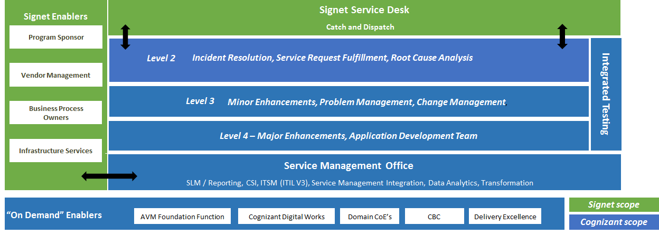
Signet Operating Model
Cognizant’s proposed service delivery model will create a collaborative delivery environment, focus on process standardization in line with ITIL and drive continual service improvements for year on year productivity improvements.
High quality services through business context aware and technical capabilities enabled L2 and L3 team.
SMO to drive analytics driven decision making and integrated governance & standardization
Service Improvements and Transformation guided by respective “On Demand” enablers

Slide 43
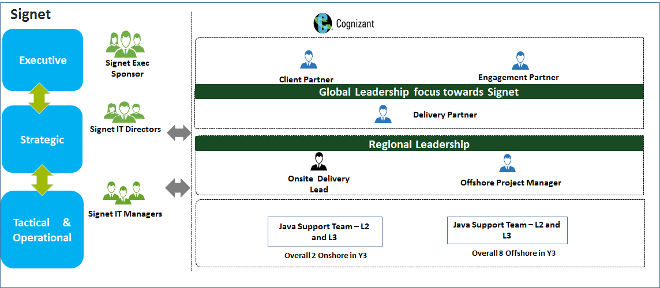
Support Organization and Governance

Slide 44
Risks and Mitigation
Risks | Mitigation
Temporary drop in user satisfaction or business interruption during transition | Transition plan to ensure sufficient resource bandwidth during the transition to Support team from Development Cognizant will adjust resource plan to accommodate peaks and troughs Signet must ensure the decided response times are agreed upon with Business and users
Connectivity Failure/Service Outage from offshore location | Cognizant has primary and secondary links for connectivity The Onsite team will act as backup for the offshore team
Unsustainable work conditions (natural disasters related risks) | Cognizant will have a robust Business Continuity Plan (BCP) in place for the engagement. Warm and Cold BCP locations would be identified and setup at offshore
Adherence to Policies / Procedures for Signet | Boot camps will be organized to educate the team members on the Signet process and procedures. The same would be reinforced through continuous communication, audits and learning sessions.

Slide 45
Why Cognizant

Slide 46
Our commitment to your success
1
Bringing Our ‘A team’ to play
2
Bringing Expert Modernization Knowledge and execution methodology
3
Bringing our Best-In-Class Delivery through Right Solution, Right People, Right Capabilities
4
Bringing Value in Accelerated Modernization through tools and accelerators
5
Our commitment to invest in the relationship

Slide 47
THANK YOU

Slide 48
Case Studies

Slide 49
Large US based Insurance Company
Key business requirements & operational applications
Key business requirements and operational application(s) re-written and supported
• Life Information Financial Transaction System (LIFTS) has two primary functions
o Online/Real-Time Processing - Policy information from Vantage – LIFTSNT
o Batch Processing - Transaction/Tax - LIFTSBP
• 28 Transaction (unique) types defined in LIFTS
o 18 Universal Life Transactions
o 10 Traditional Life Transactions
• User Base: About 280
• LIFTS was a desktop application built on Delphi technology
Scope of activities for provisioned services
Due diligence and planning
Reverse engineering of existing legacy application code base (Delphi)
Requirement elaboration and backlog creation
Wireframe, Visual design and HTML prototype development
Architecture definition and pilot development
Iterative development for Online and Batch
New database modelling
Extract user, role data from existing database and share with Nationwide for setting up in Active Directory
Test data setup for batch
Functional testing online and batch
End to end integration and parallel testing (comparison of old and new application)
UAT ,Deployment and post production support
- Project approach and resource operating model, detailing on-shore/off-shore breakdown and customer/vendor hand offs.
Key Highlights
40,000 Lines of Code of Delphi analyzed
274 User Stories created
28 Screens & 17 Worksheets developed across 2 Lines of Business
37,100 Lines of Code developed in 9 Sprints
Despite challenges with respect to Legacy skill, the Schedule Adherence is 100%
Agile Execution completely driven by Cognizant
Offshore Ratio of 80%
Transparent Reporting of Status each week, to enable Customer monitor and take decisions
To enable Users getting accustomed, multiple Demos were done for the re-written application throughout the execution of the project

Slide 50
US Grocery Super market Chain
Key business requirements & operational applications
o Key business requirements and operational application(s) re-written and supported:
• Business Requirements:
a) Primarily IT driven initiative to Reduce TCO and move over to distributed technology stack.
b) Provide Business value by providing GUI based screens and addressing few business pain points.
• Applications re-written:
a) Key applications to Java platform such as “Product Creation”, “Product information Management”, “Deals and Cost Management”, “Retail for KVIL and others” with integration through TIBCO ESB and reporting to Micro Strategy Reporting.
Scope of activities for provisioned resources
Predominantly data driven sequencing and grouping related applications
Project Approach & Resource Operating Model (detailing on-shore/off-shore breakdown and customer/vendor hand offs)
a) Perform Mainframe Revitalization to reduce TCO, mitigate legacy risks & provide intermittent business value before rewriting / replacing and final retirement.
b) A Hybrid approach with predominantly data driven sequencing and grouping related applications.

Slide 51
US Largest Car Retailer
Key business requirements & operational applications
Need to increase the time to market
Enable calculation accuracy of Business rules, TAX & FEE by maintaining single source of truth
Rewritten in .NET technologies
Scope of activities for provisioned resources
Business Rule Extraction from PowerBuilder
Designed and developed Service Oriented Architecture(SOA) Engine to perform Business rules, TAX & FEE calculations globally using .Net Technologies
Designed and developed Admin application to manage the engine and publish the metadata using .Net Technologies
Project Approach & Resource Operating Model (detailing on-shore/off-shore breakdown and customer/vendor hand offs)
Deliver the projects in Agile Mythologies using hybrid approach
Onshore / Offshore model using 50/50 ratio with required skillset for SDLC
User Acceptance Test and Sign Off

Slide 52
Assumption and Dependencies

Slide 53
Key Assumptions for Buildout Phase
Approximately 1.3 million lines of Delphi code and 425 Delphi applications in scope of the Modernization program
About 20% of code base has been considered as repetitive code, which reduces modernization effort
AS-IS non-functional requirements has to be met by the TO-BE system
AS-IS UI would be designed in the TO-BE system
Interfaces and Batch process are out of scope, any changes needed in those as part of Modernization program would be considered as “Change Request”
Infrastructure setup would be done by Signet, Infrastructure recommendation would be provided by Cognizant
Infrastructure setup cost and License cost for standing up Dev, Test, Prod is not included as part of Cognizant proposal
Infrastructure connectivity between offshore and Signet office would be setup before start of POC Phase (Month 1)
All the infrastructure access (Dev & Test) would be provided by Signet during the initial “Due-Diligence” phase (Month 0).
Signet would provide PMO, Business and IT SME as mentioned in the “Signet Involvement” slide

Slide 54
Key Assumptions and Dependencies for Managed Services
Assumptions
Enhancement request < 80 hrs. to be treated as a separate project, and will follow the agreed change request process.
Backlog of Change requests and ageing of the same will be mutually discussed, prioritized and addressed based on the spare capacity for implementing the change requests. Typically 15-20% of the capacity during the steady state is set aside for implementing CRs
Existing IMS support team will replicate issues (in case needed) for resolution of any issues in the modernized system along with Cognizant AMS team.
Dependencies
Access and appropriate level privileges for the Cognizant support team to the tools and system.
Overview session with Delphi support staff to understand the current support process, application business flows and SOPs will be required
Provide Service management point of contact within each of the service provider/ other vendors
Signet infrastructure team to notify upgrades and release of patches to application environment
Provide necessary approvals/ sign offs for Request for changes and its priority

Slide 55
Appendix

Slide 56

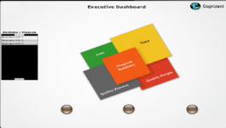
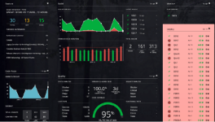
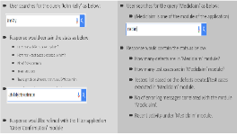
Enterprise Reporting, Metrics & SLAs
Well defined performance management framework comprising of metrics, KPIs & SLAs designed to help Signet with a transparent view of program status, application quality and costs aiding in informed decision making
CORE METRICS & KPIs | SLA CANDIDATES
Test Coverage Defect Density Response Time Adherence Test Effectiveness Defect Leakage (Across Phases) Defect Removal Efficiency (Sev 1 & 2) Defect Acceptance Rate Test Productivity (Design & Execution) | Defect Leakage into Production Schedule Variance % Regression Automation Coverage
Metrics & reporting frameworks will be defined with Signet stakeholders during Land Safe phase Metrics baselined during Land Safe phase with aid of existing toolsets & historical data Setup Intelligent Dashboards for transparent enterprise reporting | SLA framework rolled out in Run Better phase Evolve to risk reward model linked to SLAs in Run Better / Different phase
how we REPORT?
“Intelligent Dashboards with multi layered view of metrics customizable for each stakeholder groups to enable effective governance and decision-making”
Operational Module: Metrics Dashboard with role based access across executive and management
Lifecycle Module: Integrated dashboard to show release health & readiness across SDLC
Intelligent Module: Dynamic context driven dashboard which provides actionable insights

Slide 57















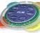



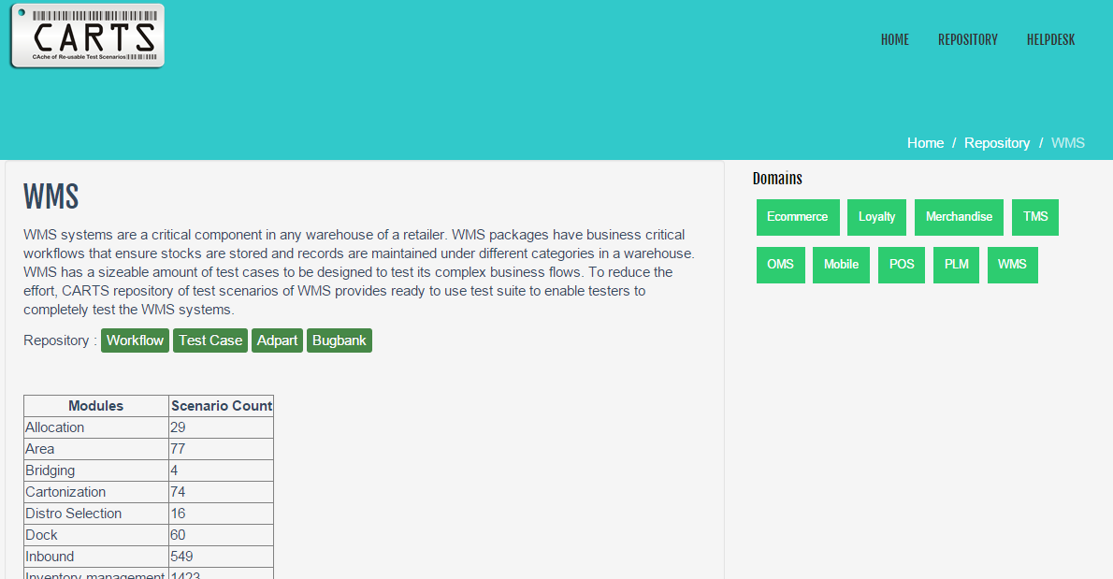
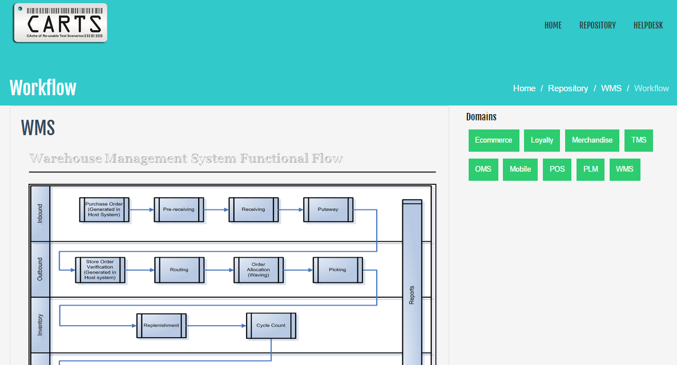
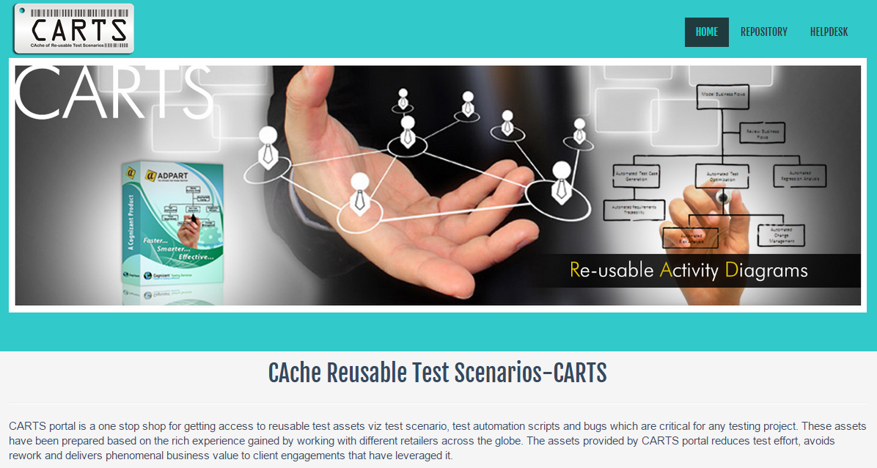
CARTS - CAche of Re-usable Test Scenarios
Cutting across different
Retail technology areas
Reusable scenarios for key IMS Modules
Process based assets that bring productivity from Day 1
Ecommerce
Distribution (DC)
Recalls STS (Store to Store)
Sell Pricing
Store Returns
Vendor Returns
Merchandising
Purchasing
Transfers
Accounting/Finance
Inventory Control
Maintenance (Sales & eComm)
Forecasting & Replenishment
18,000+ Reusable Test Scenarios across 18 modules
Oracle
TMS
Business Rules Repository
BRR
Recorded KT videos
Training & Induction Kits
Mobile
POS
WMS
Screen shot aided self study
Matured WMS process maps
OMS
PLM
Loyalty
Hands-on experience capsules
Don’t
Re-Invent
the
Bug Bank – 1650+ Defects
!
1,500+ Test Scenarios for IMS, 2,500+ for Merchandising
25+ ADPART Process Flowcharts around Inventory Management
https://carts.cognizant.com
Proven Success Story
50% effort reduction on CARTS usage

Slide 58

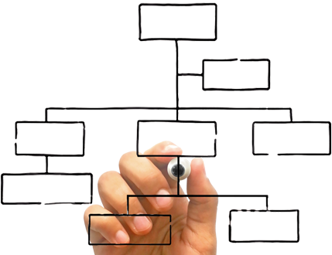




Model-based Test Design Automation Engine [ADPART]
ADPART , an end-to-end test design automation product that enables businesses experience faster release cycles with impeccable quality
About
ADPART
Patented model based Test design automation product
Implemented across more than 120 clients
Widely Acknowledged by Industry Research & Advisory organizations
Model Business Flows
Automated Test case generation
Traceability & Test Optimization
Impact & Change based analysis
Risk Based Testing
Regression Analysis
Seamless Integration with HP ALM , CA Agile Central , Jira , TFS
Reverse Engineering
Key
Features
Review Business
Flows
Automated Test Case Generation
Automated Test
Optimisation
Automated
Regression Analysis
What are the benefits ?
Automated Reqt
Traceability
… Faster …
… Effective …
… Smarter …
Automated Test Creation
Test Selection
Regression Analysis
Knowledge Transfer
Requirement Analysis
Requirement Traceability
Better Coverage
Change Management
Test Optimisation
Rule Based Test Creation
Risk Based Testing
Testing Business Criticality
Automated
Risk Analysis
Automated Change
Management
30% Optimized Test Cycle time
100 % Quality Coverage
25% Effort Savings

Slide 59






Scriptless Automation powered by Cognizant Intelligent Test Scripter
CITS
Grid/Multi-browser Execution
Execution Layer
Dashboard
15%
Of overall software development project cost is spent on automation – skill and framework development.
Cognizant Intelligent Test Scripter
An open source, script-less test automation platform built with Selenium WebDriver , Sikuli and Appium. The CITS platform supports both web and mobile browser automation and also provides support for exploratory testing.
CITS IDE
35%
Is the total effort spent on test automation maintenance.
Test Plan Module
Test Data Module
Object Management Module
CITS Engine
Keyword abstraction
CRAFT
Of all development costs* is due to the frequent changes to the application.
Sikuli
Appium
Galen
70%
Selenium WebDriver
Object
Skeleton
BENEFITS |  | Simple to Use Keyword abstraction of tests eliminates the need for resources with niche automation skills. |  | Faster ROI 60% faster ROI realized compared to traditional automation with Selenium.
 |  | Early Automation Users can design navigation flows before the application is ready. |  | Business Friendly Support ‘business acceptance’ without constraints of scripted testing.
 |  | Rapid Test Development User friendly IDE with recording, drag-drop and auto- complete features promote rapid test development. |  | Increase Reusability Repurpose CITS tests between mobile and desktop applications.

Slide 60



Service Virtualization using SmartStub
SmartStub, an integrated radical technology for next generation service Virtualisation platform – It is an advanced product-form of the common IT exercise known as “mocking and stubbing”
Unique Features
Key Benefits
Plugin Based Framework to Virtualize service components using VADS(Virtual Actively Delegated Stub) mechanism
Supported protocols and data formats
HTTP /HTTPS, TCP
SOAP/WSDL web services
REST, XML and JSON
IBM MQ for SOAP, XML, Text, Byte, Object and Stream
Provides multiple methods for Virtual Service creation
Implicit and Explicit Traffic Recording options
External integration with different data sources for Response data generation
Direct import and export of packages virtual services
Support for dynamic data-sets, aggregates and variable tag creation
Minimal cost of license.
Technology specific licensing Model - Pay only for Virtualisation of required technologies.
Eliminate CAPEX on Comprehensive Commercial tools
Achieve essentials tasks Without Complex development
Quick and easy integration with other enterprise tools/systems like
Test data management
Existing Stub/Business components
Industry specific virtual packages
Enable collaborative testing an d development tasks in agile SDLC
Offers key benefits as best-suited for NFT
Record/Extract
Enhance
Deploy
Share and Use
3+1 Step
Process
Multiple options to create VS
- Record the live traffic, Create from pairs, WSDLs, URLs, and templates
Enhance the virtual service with external data sources, new set of transactions, Java Scripts, variables or dynamic data updates in most user friendly UI
Deploy a new virtual web service & update the endpoint details with users
Start using the smart virtual service, one can dynamically update the data to update service behavior.

Slide 61


Regression Test Approach
2
Creation of Manual Regression Test Suite
4
Execute Regression Test Suite
Evaluate the system test cases to identify the regression test case
Execute test case
Record results
Analyze defect data
System Test Cases
1
Create Scenario for determining Regression Coverage
Setup Regression Test Suite
Master Regression Test Suite
Business Criticality
Complexity
Usage Frequency
Map to Scenario and Evaluate scope for improvement
5
Regression Test Suite Optimization & Maintenance
Perform risk profiling of the functionalities to determine functional coverage
3
Creation of Automation Test Suite
Requirements / Defect Fixes
Risk Based Testing
Conduct Feasibility Study for Automation Candidates
Perform test impact analysis based on test requirements
Prioritize regression test cases
Create test scripts for automatable components
The above regression automation test approach would be conducted for all phases (ph1 – ph3)
Around 60% of the functional scenarios would be considered for regression and approx. 40% of the regression scenarios would be automated
Automation tool (CITS) feasibility & POC would be conducted during the migration prep of Phase-1

Slide 62
Support Tools and Accelerators
Cognizant will leverage ServiceNow (Signet instance) as IT Service Management tool to deliver managed services support . We recommend leveraging KEDB module of ServiceNow for KM and KEDB management.
Additionally Cognizant will bring in below mentioned Tools and Accelerators as value add at no extra cost:
Tool/Accelerator | Function
AppInsight | A shared knowledge repository of all apps to provide deeper insights about Business Transactions, Use cases, Impact of change, design and Code Quality of Applications
KT Navigator | Portal to track transition progress and effectiveness with real time view of the progress on KT given to Signet
AVM DART | One stop solution for Support Analytics, reporting and dash-boarding

Slide 63
































Test Process Repository
Key Considerations
End to End analysis of Value chain & a holistic approach to assessments focusing on institutionalizing continuous improvements
Change readiness & risk assessments and action plan for Change Management & Risk Management
No Disruption of BAU Test Activities through ‘Transform while Perform’
Phased Transformation Roadmap : Setup >> Operate >> Optimize
Governance
Establish Standards & Norms
Ensure compliance
Set direction of QA organization
Accountable
Ensure Operational Readiness
Organizational Exception Management
Establishing QA for Signet
Operations
Demand Management
Metrics Reporting
Delivery Compliance
Test Process Management
Delivery
Resource Management
Delivery Ownership - Test Strategy, Schedule, and Cost
Program Exception Management
Transformation
Quality/ Maturity Assessment Models
Transformational
Objectives & Roadmap
Transformation Governance
Implementation

Slide 64


Knowledge Management
QA & Process Artifacts
Test Artefacts | Communication & Escalation Maps | Work Intake Workflows | Metrics | Acceptance Criteria
Lessons Learnt & Best Practices
Consumer Analytics Insights | Innovations | Best Practices
Application Knowledge
Business Process Models (ADPART) | Business Requirements | Program / Project Plans | Transition / Application Documents
Tools & Infrastructure
Usage Guidelines | Owners | Checklists | Environment Planning Guidelines | Release Management Framework
KNOWLEDGE MANAGEMENT
PLATFORM
Wiki Portal
MS SharePoint
ALM/JIRA
Dashboard
Enabled by
Wiki enabled Test Artefacts
E-Learning Kits
Boot Camp materials
Gamification
Class Room Trainings
KNOWLEDGE MANAGEMENT OUTCOMES
Reusability
Cross leverage test & process artifacts to minimize redundant effort
Team Onboarding
Base for executing boot camps through detailed induction kits
People Enrichment
Training & cross skilling of TCOE associates
Collaboration
Sharing of best practices across regions & teams

Slide 65
Defect Management
Structured defect management process to minimize the critical defect slippage by prioritizing and categorizing
Implementation Team
BEST PRACTICES
DEFECT SUBMISSION GUIDELINES Ensure two way traceability matrixes, from Requirement to Defects and Defects to Requirements will be created in ALM
DEFECT SEVERITY Right classification of degree of impact the defect has on the development or operation of a system
DEFECT MANAGEMENT TOOLS To enable traceability with requirements & ease of collaboration in defect reporting & triaging
Analyze defect in detail
Develop / Implement fix
Unit Test
Defect Triage Meeting
Discuss defect in detail
Prioritize and categorize the defect
Notify
Notify
Raise Defect in Defect Mgt. Tool
Retest the build for defect fix
Defect found in the execution cycle
Re-open
NO
Fixed?
Close Defect
YES

